Slide 1
UE18CS390B –Project Phase – 2
Project Progress Review #3
Project Title : Smart Classroom Environment
Project ID : 71
Project Guide : Dr. Annapurna D
Project Team : Akshaya Visvanathan (PES2201800089)
Bhavan Naik (PES2201800047)
Akhil S Kumar (PES2201800137)
Atharva Moghe (PES2201800131)

Slide 2
Outline
Abstract and Scope of the Project
Suggestions from Review – 2
Implementation Details
Project Demonstration
Test Plan and Strategy
Results and Discussion
Project Report Draft
Conclusion and Future Work
References
IEEE Draft

Slide 3
Abstract and Scope
Problem Statement:
A proposal for an IoT-based intelligent environment, with the primary objective of energy optimization and an intelligent, yet reliable attendance system that focuses on reducing latency to give an enhanced learning experience.
Abstract:
For a long time, attendance has always been taken manually. This has caused multiple discrepancies and has wasted useful class time.
In addition to this, classroom equipment like fans etc. have occasionally been left on thereby wasting considerable energy.
Scope:
We are planning to firstly implement this project in our own campus and then extend it to other institutions.

Slide 4
Suggestions from Review - 2
Provide the suggestions and remarks given by the panel members:
Concerns on type of ML/AI analysis used for the Project.
IEEE Report
Mention the feasibility on the same showing the progress:
Explored Data Visualization and Model Building in Google Colab and Neo4j graph database application as a tool for visualization.
IEEE Report is in progress.

Slide 5
Implementation Details
Attendance Module:
Attendance can be taken electronically by means of a biometric optical fingerprint scanner.
Security and integrity can be ensured by making the biometric module portable and modular - a small phone sized module carried by the teachers.
The teacher can pass around/have each of the students scan their prints and register their attendance with no manual intervention.

Slide 6
Implementation Details
Electricity Optimization Module:
Spatial sensors placed at the edges of classrooms will notify the system of movement and activity in the room.
Edge computed algorithms ensure that the lights and fans are turned on only at specific portions of the room incase of a large classroom/hallway.
In case of manual fans, temperature monitors are used to add a level of cost-effective automation.

Slide 7
Project Demonstration
Demonstration Components:
Attendance Module: Bhavan
Electricity Optimization Module: Akshaya
Windows Application: Akhil
Database and Analysis: Atharva

Slide 8
Test Plan and Strategy
Attendance Module:
Checking if fingerprint scanner is working or not.
Checking if fingerprint scanner is able to map the fingerprint to the ID of the student.
Checking if the data sent to the database is correct or not.
Electricity Optimization Module:
Checking if the module senses motion.
Checking if the module sends correct data to the database.

Slide 9
Test Plan and Strategy
Windows Application:
Checking if the app is able to change/update the database.
Checking if the app is able to handle multiple logins at the same time.
Checking if the app gives the right data back to the admin.
Database System:
Checking the data sent by fingerprint scanner and map it to the correct class and marking the status.
Checking the data sent by the electricity optimization module and add correct values to the database.
Checking of the data given by the system to the admin is correct or not.

Slide 10
Results and Discussion
Results are the same as expected.
All the modules are working as they are supposed to be running.
The only deviation from the original plan is that we were not able to collect data from all students due to the pandemic and only data belonging to the group members is used in this project.

Slide 11
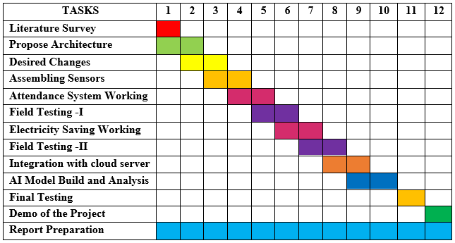
Timeline – Update on Tasks

Slide 12
Conclusion and Future work
Conclusions:
The project is completed.
Only the IEEE Report is left to be done.
Future work:
To extend the project from one institution to multiple institution level.
Add a couple of other modules to get all-in-one feature system.

Slide 13
References
M. Caţă, "Smart university, a new concept in the Internet of Things," 2015 14th RoEduNet International Conference - Networking in Education and Research (RoEduNet NER), 2015, pp. 195-197, doi: 10.1109/RoEduNet.2015.7311993.
Q. Miao, F. Xiao, H. Huang, L. Sun and R. Wang, "Smart attendance system based on frequency distribution algorithm with passive RFID tags," in Tsinghua Science and Technology, vol. 25, no. 2, pp. 217-226, April 2020, doi: 10.26599/TST.2018.9010141.
Suresh S., H. N. S. Anusha, T. Rajath, P. Soundarya and S. V. P. Vudatha, "Automatic lighting and Control System For Classroom," 2016 International Conference on ICT in Business Industry & Government (ICTBIG), 2016, pp. 1-6, doi: 10.1109/ICTBIG.2016.7892666.
S. Bhattacharya, G. S. Nainala, P. Das and A. Routray, "Smart Attendance Monitoring System (SAMS): A Face Recognition Based Attendance System for Classroom Environment," 2018 IEEE 18th International Conference on Advanced Learning Technologies (ICALT), 2018, pp. 358-360, doi: 10.1109/ICALT.2018.00090.

Slide 14
IEEE Draft (Optional)
IEEE Report Draft Link: https://docs.google.com/document/d/1qxi3upmOSM61n3BVeq5PylEkey1lJMuf/
Status of Completion: 30%

Slide 15
Thank You

